Slide 1
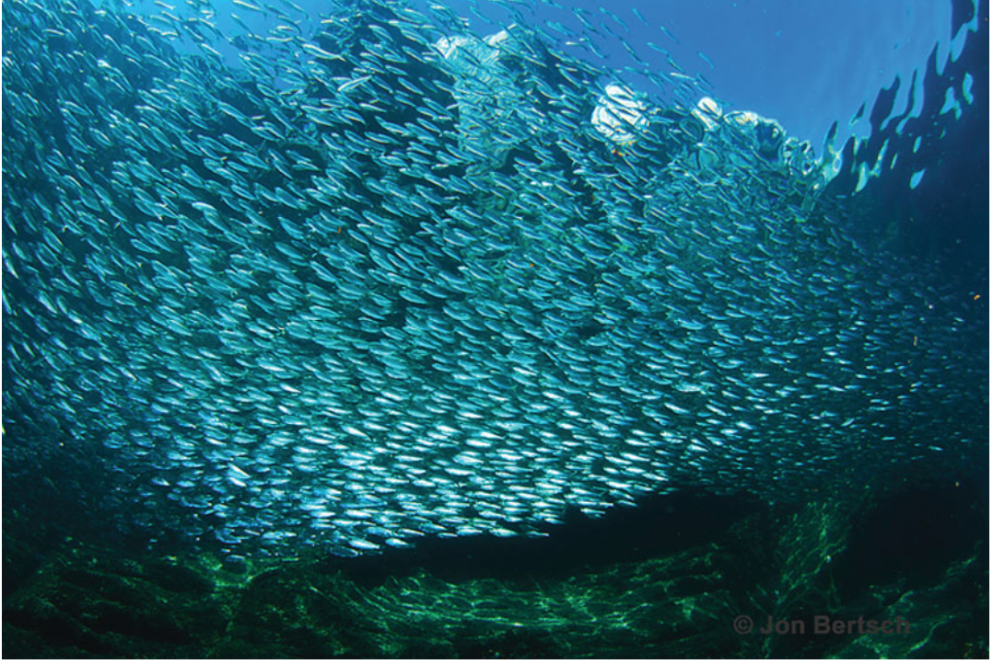
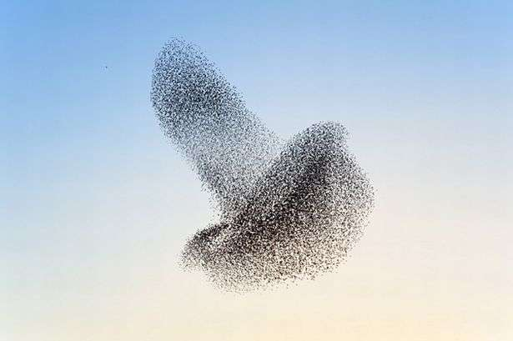
Active Matter
Flocking, Self-propelled, Chiral & Chemotactic

Slide 2
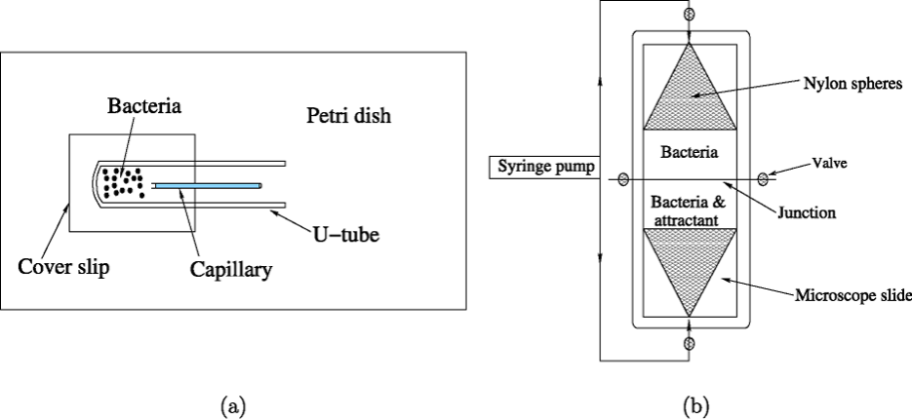
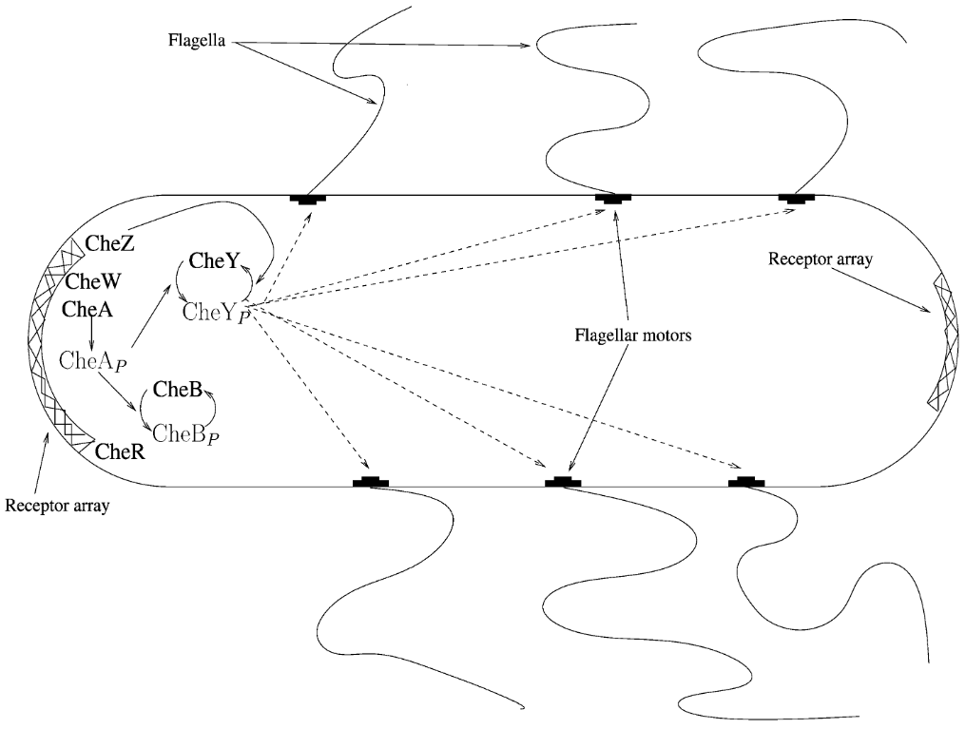
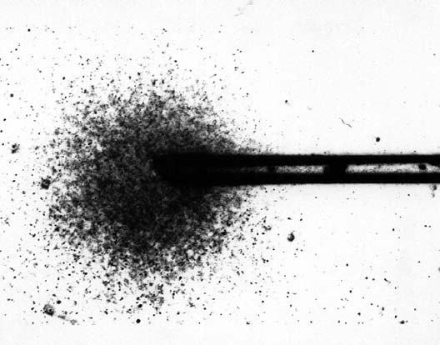
Chemotaxis Bacteria
[1] M. J. Tindall, P. K. Maini, S. L. Porter, and J. P. Armitage, Overview of Mathematical Approaches Used to Model Bacterial Chemotaxis II: Bacterial Populations, Bull. Math. Biol. 70, 1570 (2008).

Slide 3
Agent-based Chemotaxis Model to Smoluchowski Equation
Single Agent
Generalized Keller–Segel (K–S) model
Multi Agents
[1] Keller, E., Segel, L., 1970. Initiation of slime mold aggregation viewed as an instability. J. Theor. Biol. 26, 399–415.
[2] Keller, E., Segel, L., 1971a. Model for chemotaxis. J. Theor. Biol. 30(2), 225–234.
A trivial solution:
Uniform disordered phase / Equilibrium state
Smoluchowski Equation

Slide 4
Keller−Segel instability
Smoluchowski Equation
Take the form of a plane wave:
Symbol | Means
 | growth rate
 | wave vector (representing the oscillation mode in space)
 | wave numbers (LSA usually focuses on the corresponding to different wave numbers)
Linear stability analysis

Slide 5
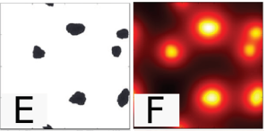
Keller−Segel instability
This can be written in matrix form
Keller−Segel instability:
In order to have non-zero solutions, the det of the coefficient matrix must be 0:
The Keller−Segel instability leads to clusters of active particles and colocated clusters of the self-produced chemical that grow in the coarse of the time due to coarsening and cluster coalescence:

Slide 6
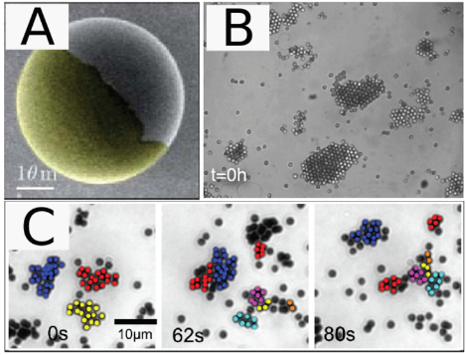
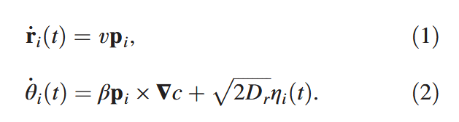
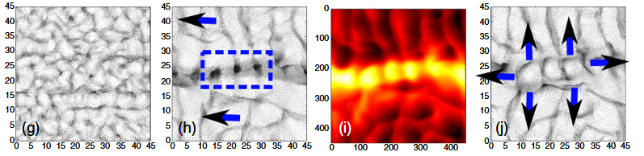
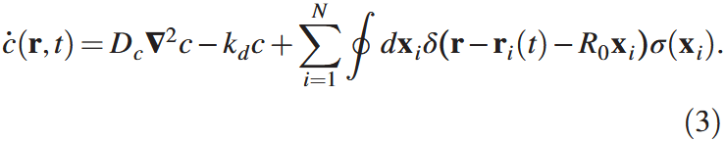
Chemotaxis Self-propelled Particles
Janus colloid
Phoretic Interactions Generically Induce Dynamic Clusters and Wave Patterns in Active Colloids:
[1] B. Liebchen, D. Marenduzzo, and M. E. Cates, Phoretic Interactions Generically Induce Dynamic Clusters and Wave Patterns in Active Colloids, Phys. Rev. Lett. 118, 268001 (2017).

Slide 7
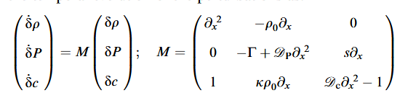
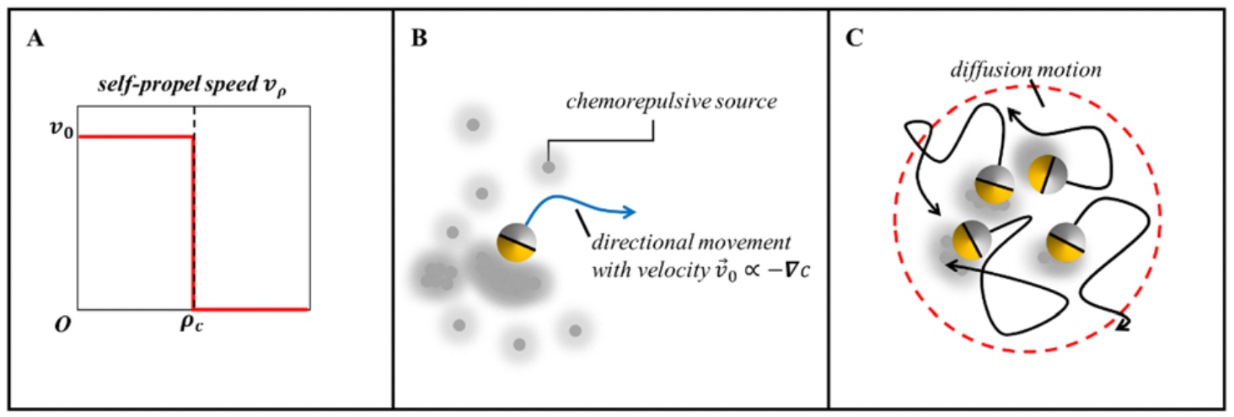
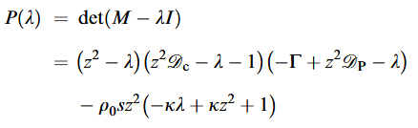
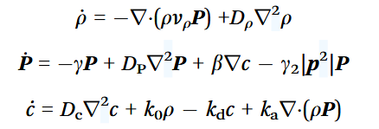
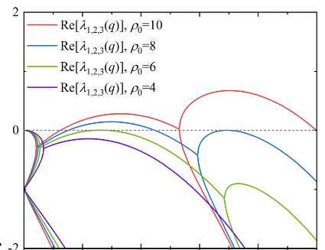
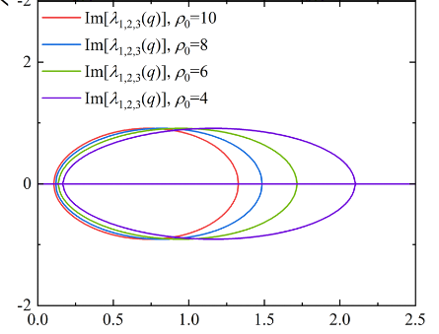
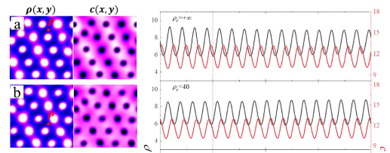
A Variety of Chemotaxis Particles
Quorum sensing-induced transition
[1] J. Cao, J. Wu, and Z. Hou, Quorum sensing-induced transition from colloidal waves to Turing-like patterns in chemorepulsive active colloids, Phys. Chem. Chem. Phys. 26, 7783 (2024).

Slide 8
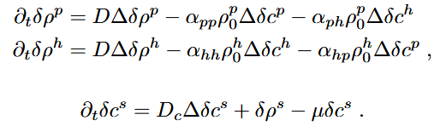
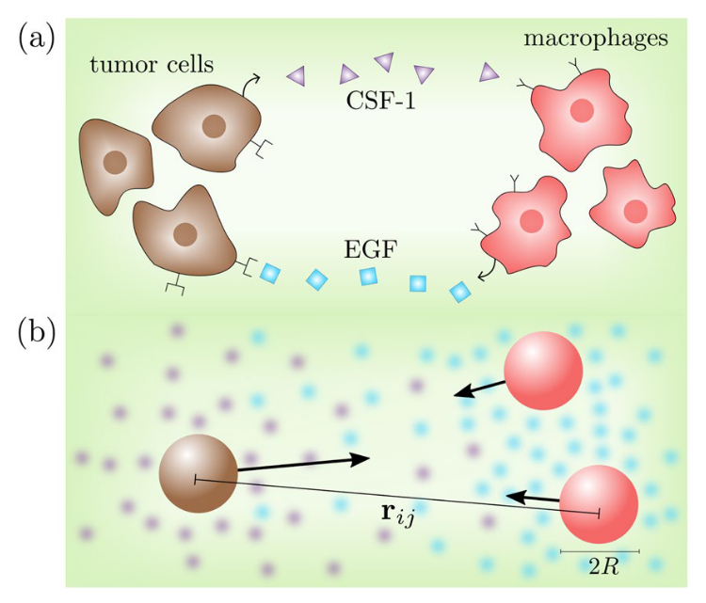
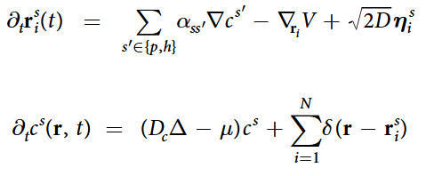
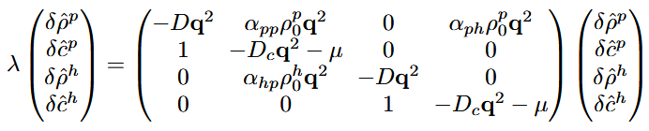
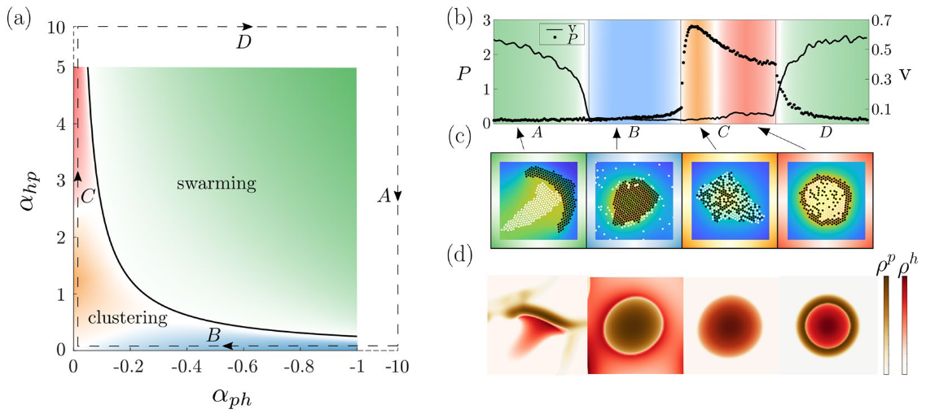
A Variety of Chemotaxis Particles
Swarm Hunting in chemically communicating Active Mixtures
The steady state is stable, if the eigenvalues of the matrix all have real parts strictly less than zero.
The steady state is unstable, if at least one of the eigenvalues of the matrix has a positive real part.
Otherwise in the marginal case higher order terms determine the stability of the problem.
[1] J. Grauer, H. Löwen, A. Be’er, and B. Liebchen, Swarm Hunting and Cluster Ejections in Chemically Communicating Active Mixtures, Sci Rep 10, 5594 (2020).

Slide 9
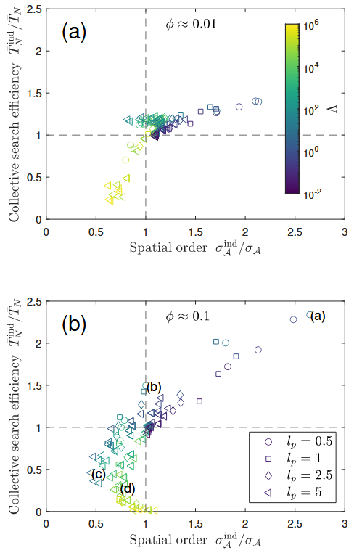
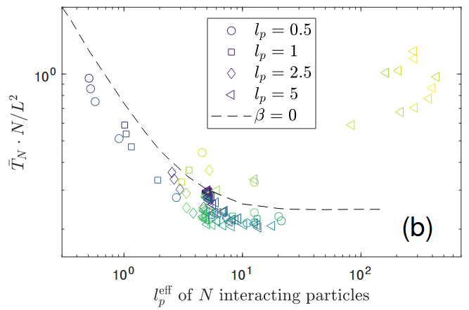
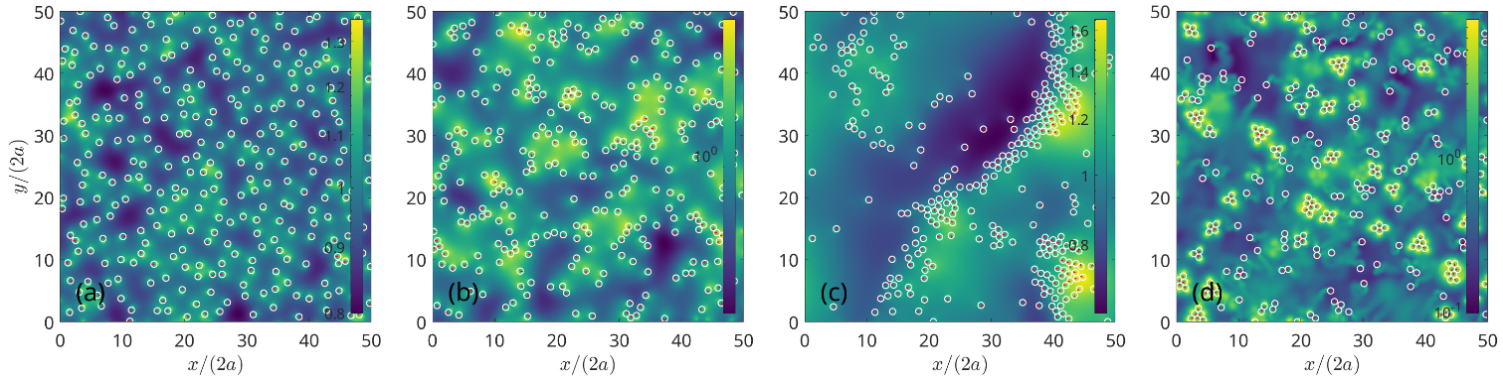
Application of Chemotaxis Particles
Collective chemotactic search strategies
[1] H. Meyer, A. Wysocki, and H. Rieger, Collective Chemotactic Search Strategies, arXiv:2409.04262.

